Slide 1
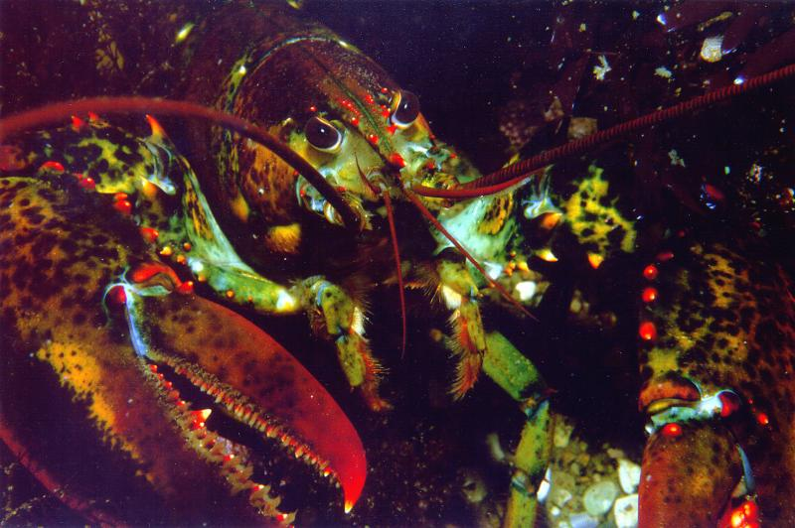

Maine Lobstermen Working to Reduce Right Whale Entanglements
March 2017

Slide 2
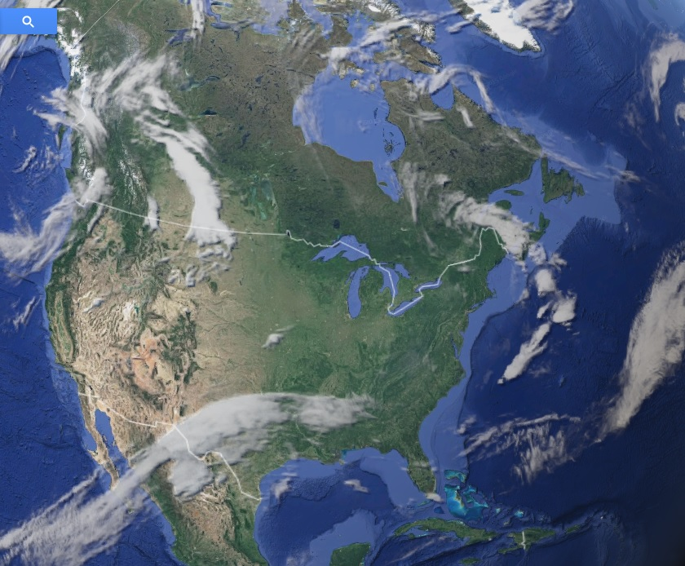
Maine, USA

Slide 3
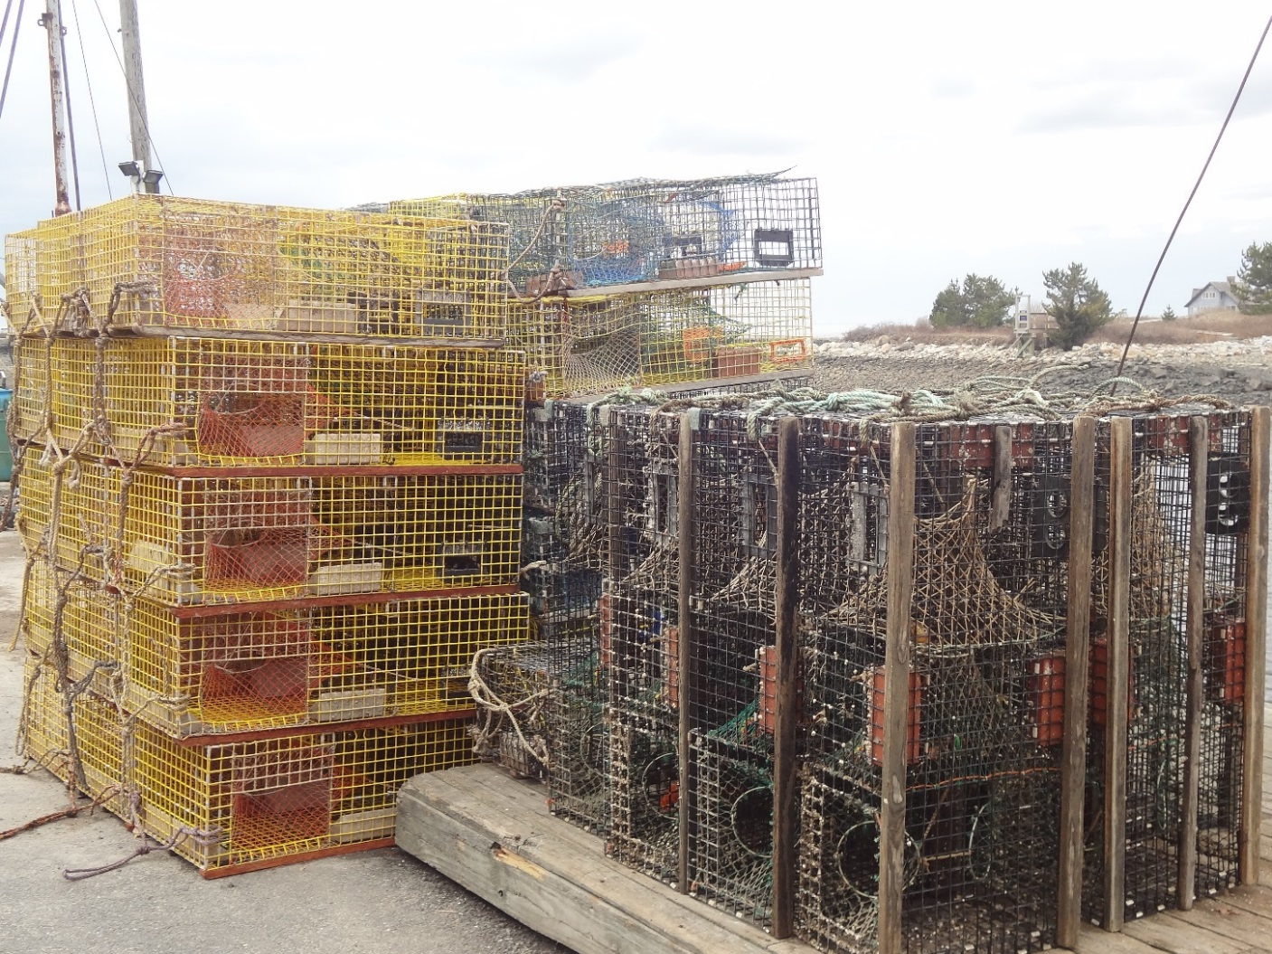
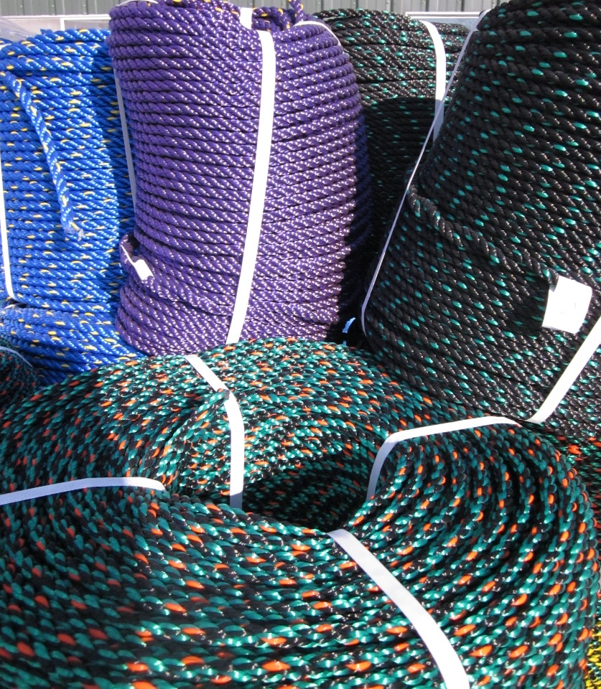
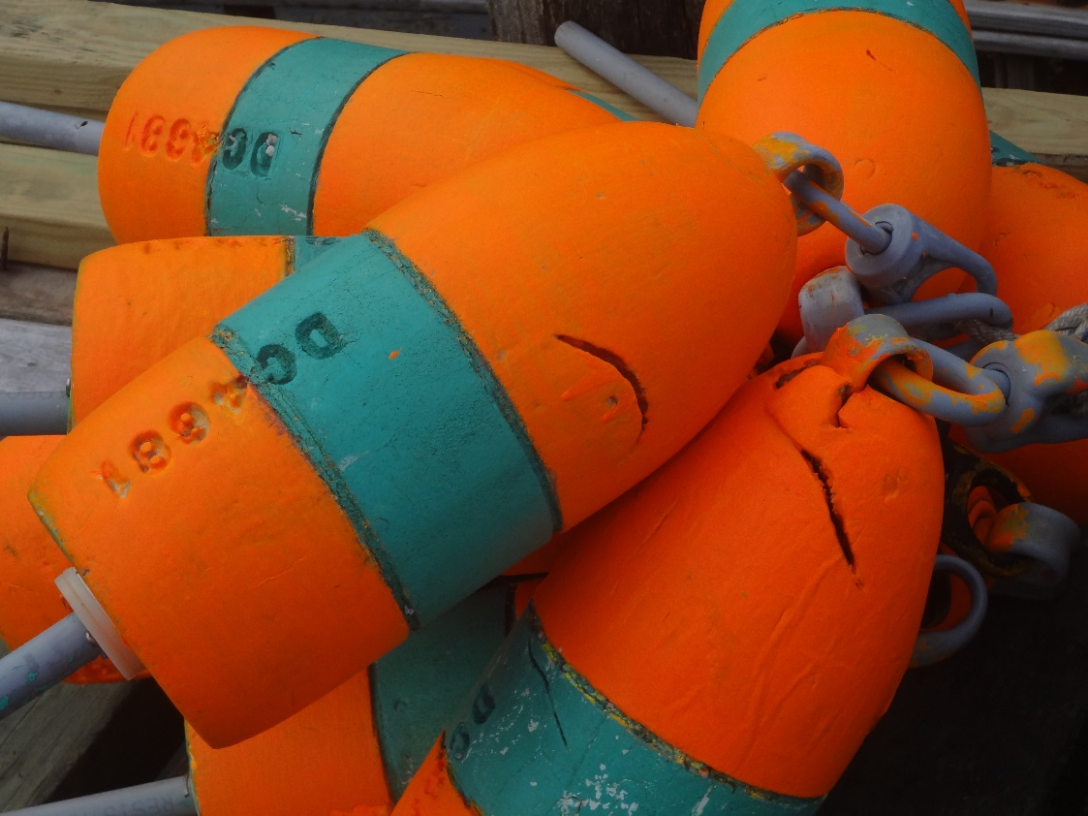
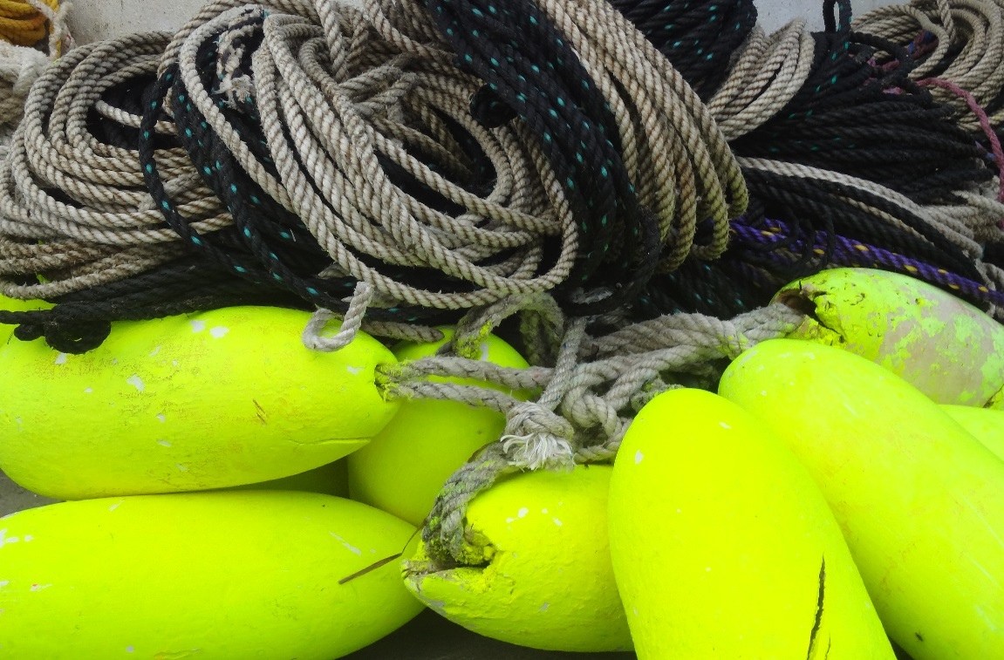
Tools of the Fishery

Slide 4
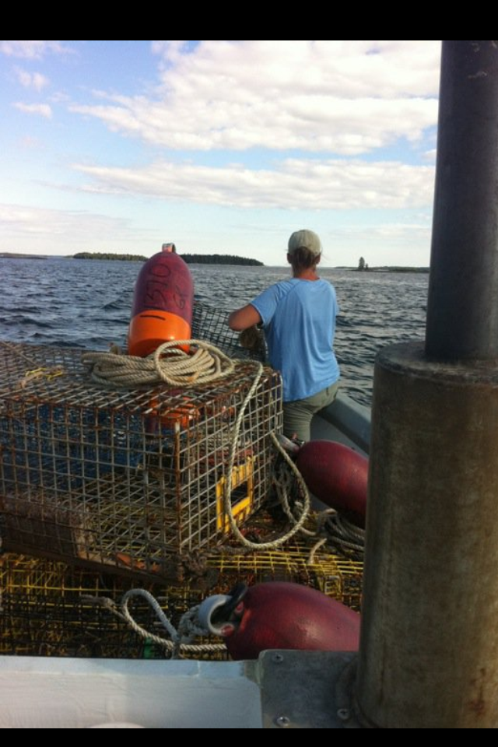

Slide 5
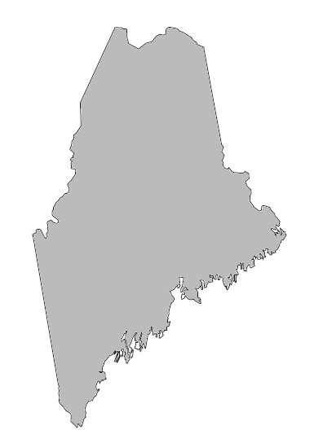
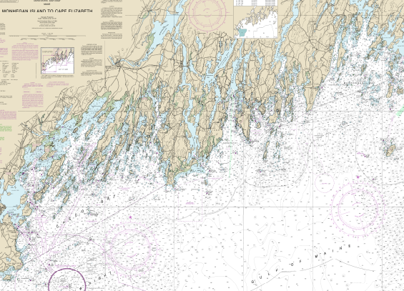
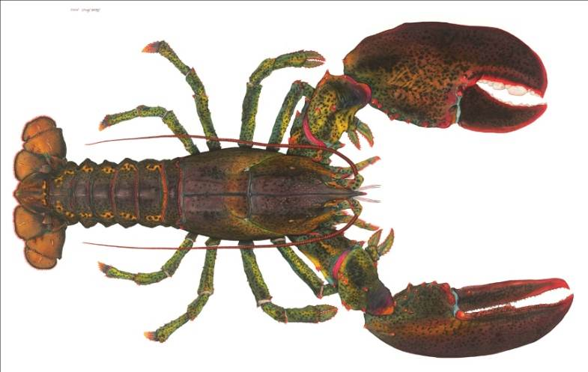
Maine Lobster Industry…. Billion + $ industry
Maine lobstermen live along 3,500+ mile coastline in small, rural communities
Our communities are located on remote peninsulas and 15 year- round islands
Maine coast is dependent upon lobstering
Notes:
Maine lobstermen

Slide 6
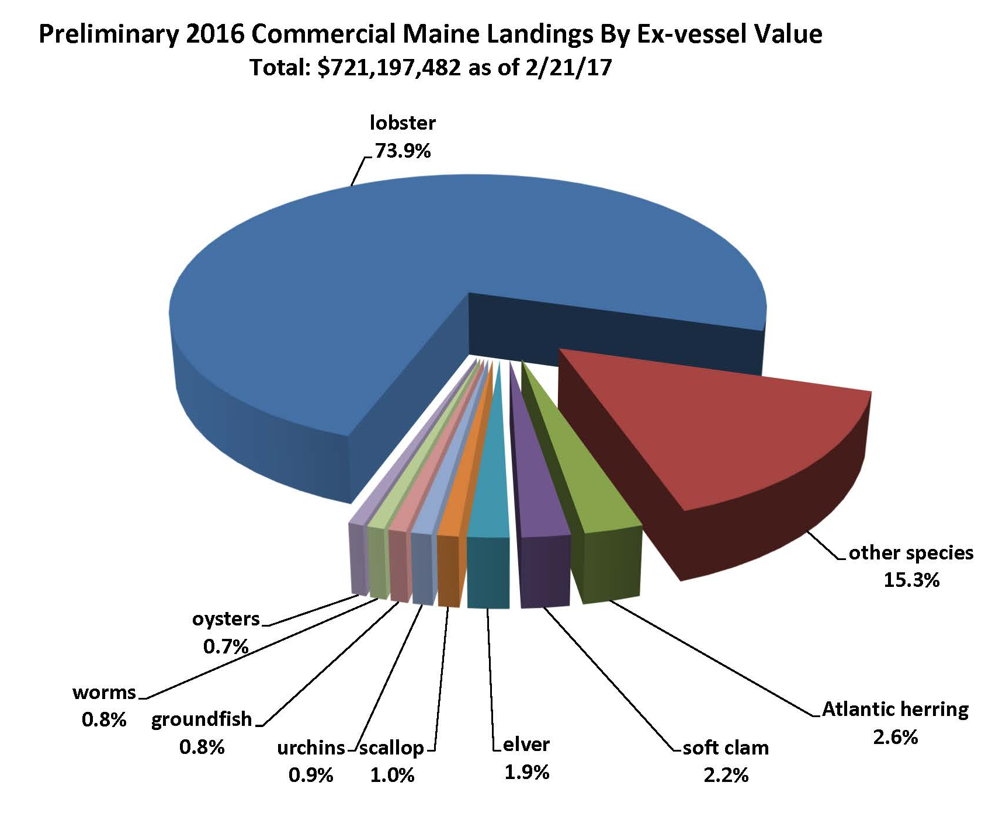
Maine lobster vs. other fisheries by value

Slide 7
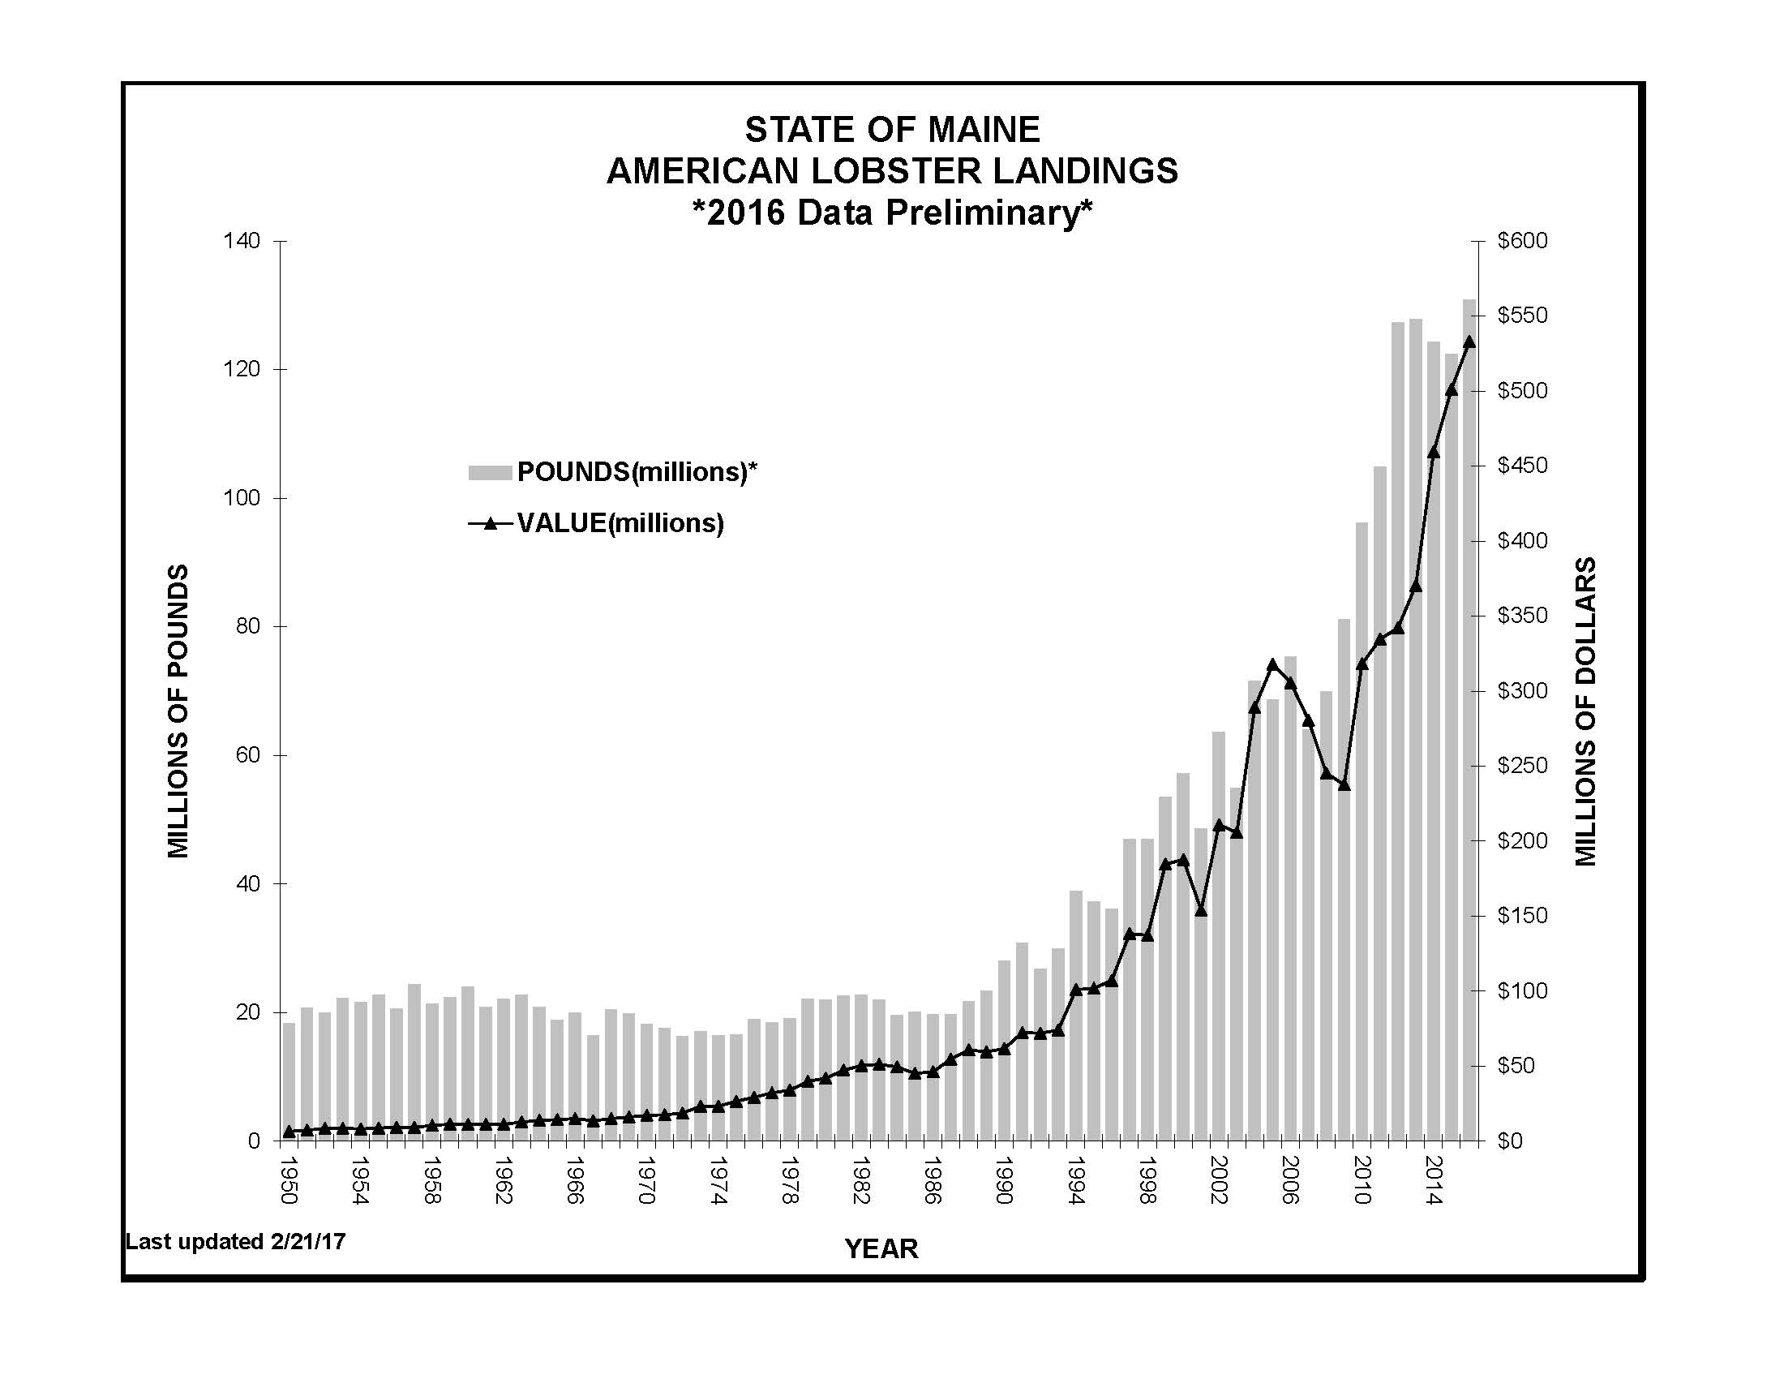
Record lobster landings and value
Landings: 130,844,773 lbs
Value: $533,094,366

Slide 8
Seasonal lobster landings
In 2016:
Year-round fishery
83% of catch July to Nov
80% of Maine lobster is New Shell
Notes:
Same overall seasonal pattern with fishery picking up in July
But 2014 landings below 2012 levels for June-Aug; stronger Sept to Dec
Next slide really shows that

Slide 9
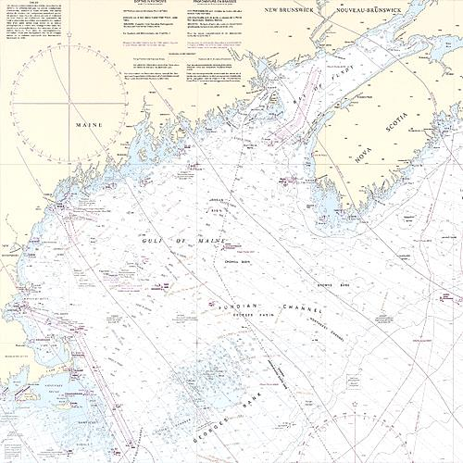
Source: Maine DMR
Maine Lobster Fishery at a Glance
4,404 commercial licenses issued (2015)
    ~70% are active (3,082)
    ~60% landed > 1,000 lbs (2,642)
880 students and 230 apprentices
Max limit of 800 traps (or less)
  ~2.73 million trap tags issued; (includes 63k student tags)
  ~2.18 million trap tags > 1,000 lbs (80%)

Slide 10
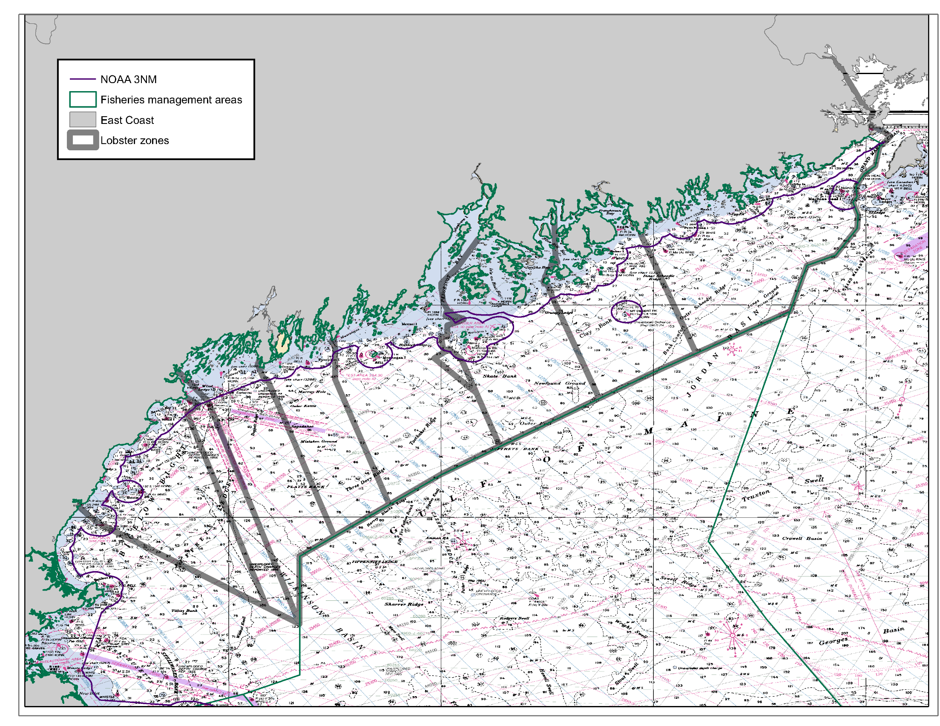
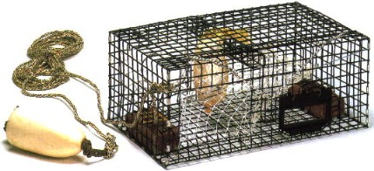
Only 20% hold permit to fish federal waters (~1,300)
All ME lobstermen may fish in state waters
(4,400 lobstermen and 880 students)
A
B
D
C
E
F
G

Slide 11
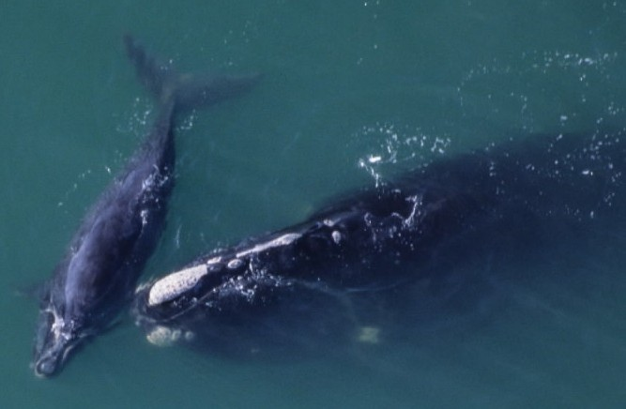
The Whale Plan

Slide 12
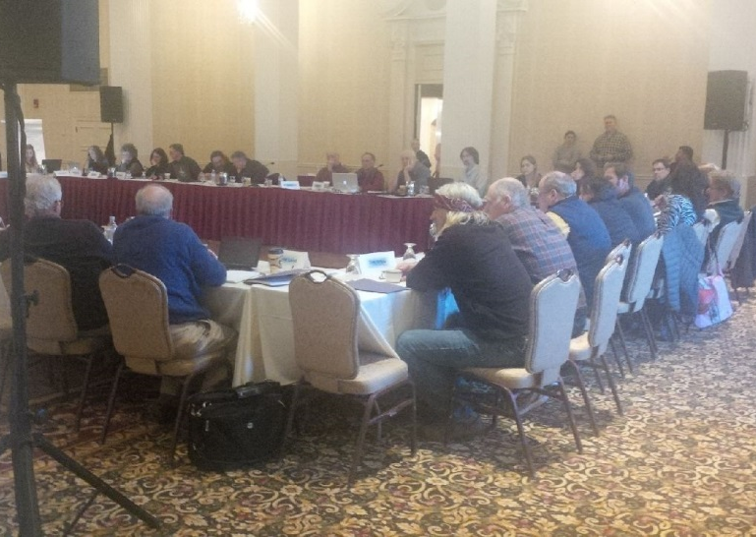
Atlantic Large Whale Take Reduction Team
Covers fixed gear fisheries from Maine to Florida
TRT members have diverse constituencies
It requires compromise
Maine TRT members, Lobstermen Jim Tripp and Dwight Carver

Slide 13
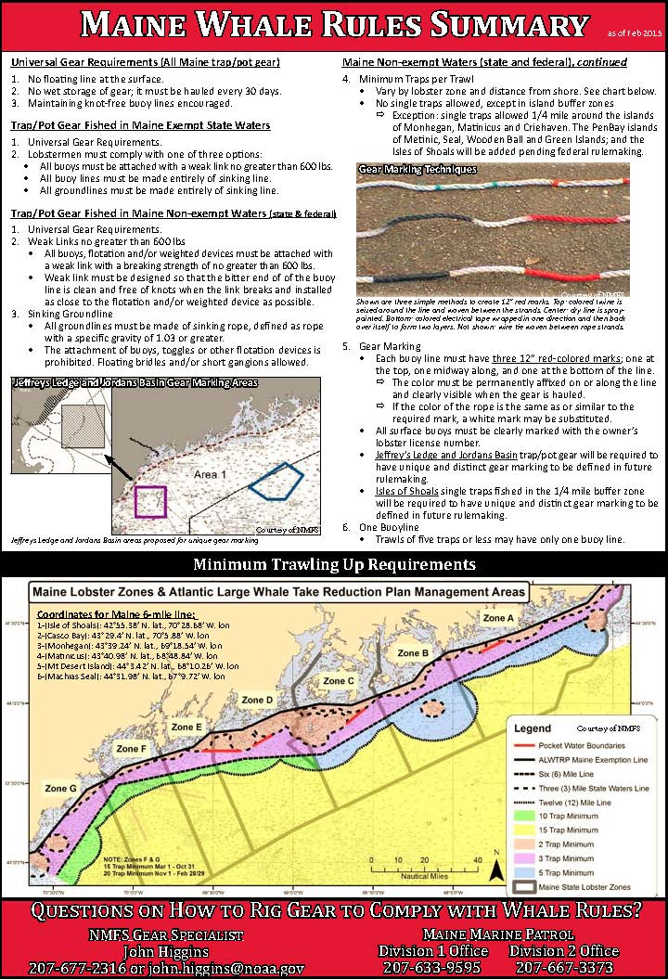
Whale Rules
Universal measures
  No float line at surface
  No wet storage
  Rope as knot-free as possible
Exempt waters
  Choose one: weak link, sinking rope buoy lines or sinking groundlines
Non-exempt waters
  600 lb weak link
  Sinking groundline
  Gear marking 3 x 12” marks
  Unique marking for Jeffreys, Jordans and Isles of Shoals)
  1 buoy line on trawls of 5 traps or less
  Minimum traps per trawl increases with distance from shore; vary by zone
    pairs – non-exempt state waters
    Triples – out to 6 miles
    5’s – eastern Maine out to 12 miles
    10’s – western Maine out to 12 miles
    15’s – 12+ miles
    20’s – F and G (Nov thru Feb)
Notes:
9:30
A full page summary of the whale rules is printed in the March edition of Landings.
New measures in place for June 2015
Trawling up requirements, expanded gear marking of 3 x 12” marks

Slide 14
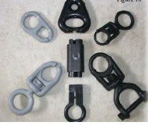
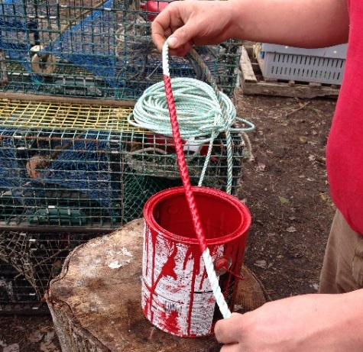
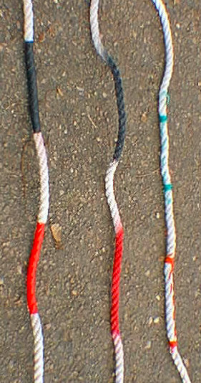
Evolution of Whale Plan
Universal requirements [1999]
  No float line at surface
  No wet storage
  Rope as knot-free as possible
  Gear technology list (VL sink rope, GL sink rope, 1100 lb weak link, 7/16” diameter rope)
600 lb weak links & 4” Gear marking VL [2005]
Dynamic Area Management [2003-2008]

Slide 15
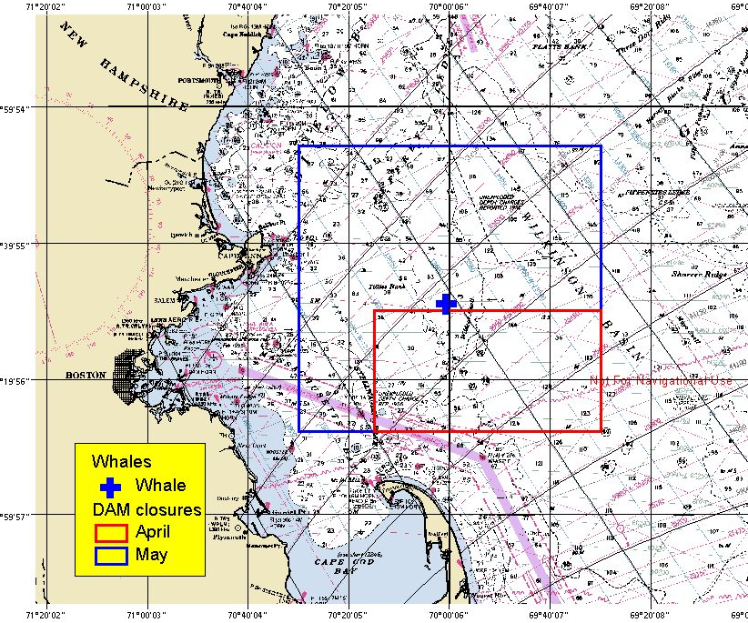
Dynamic Area Management
Lobstermen required to remove all gear from the area immediately

Slide 16
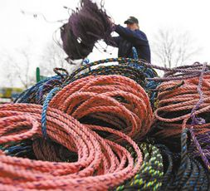
Evolution of Whale Plan
1) Groundlines [2009] and 2) Vertical Lines [2015]
Sinking Groundlines
Broad-based rule for all fixed gear fisheries on Atlantic Coast
Maine exemption line inside state waters
Maine fought this rule:
Rocky, hard bottom inshore
Few right whales sighted inshore
Tried to develop alternative low profile rope

Slide 17
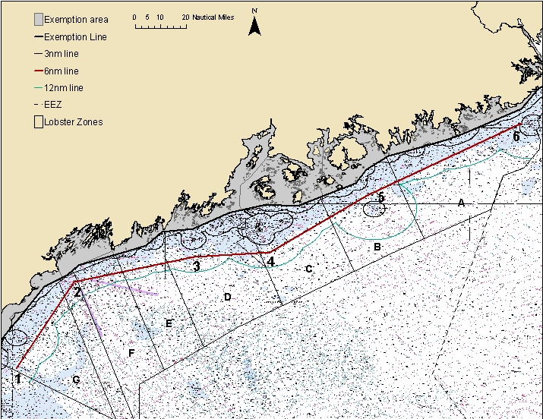
Maine exemption line
~70% of state waters exempt

Slide 18
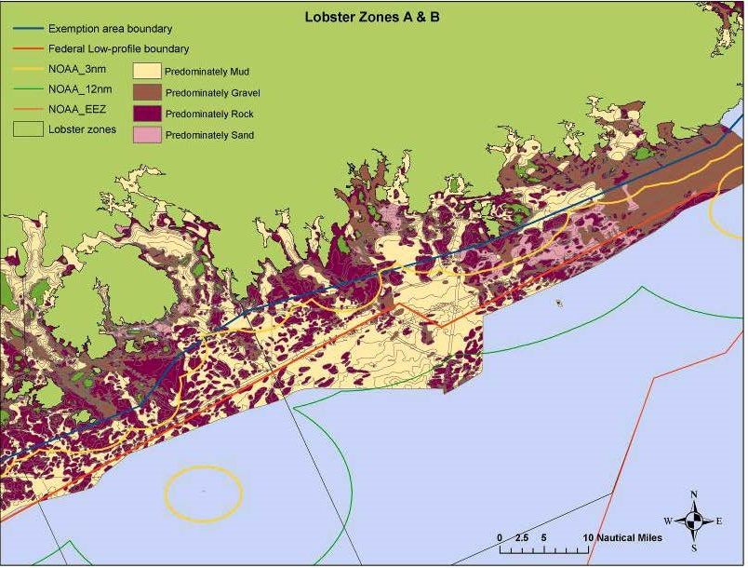
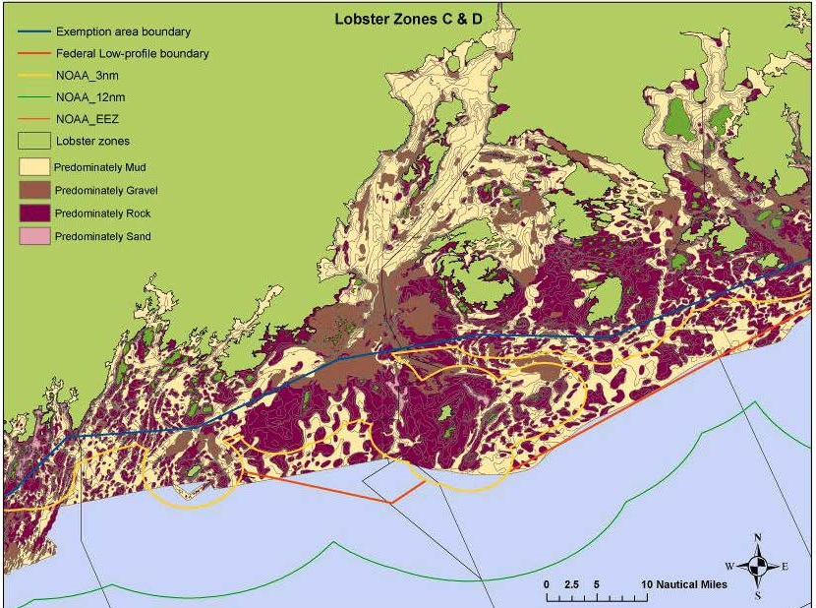
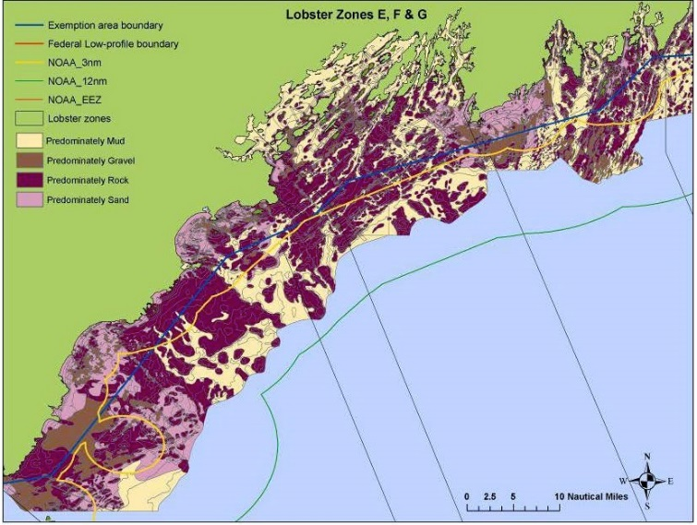
Maine has rocky bottom

Slide 19
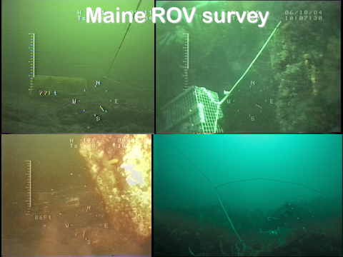

Slide 20
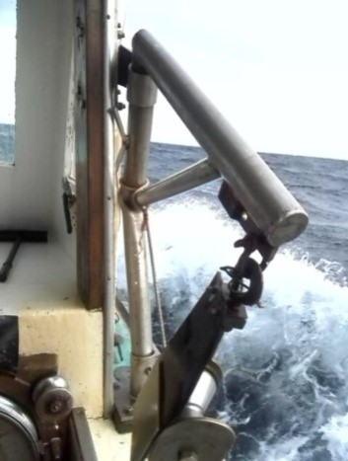
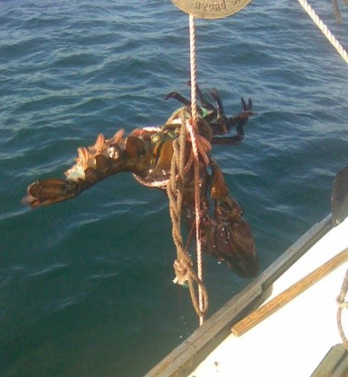
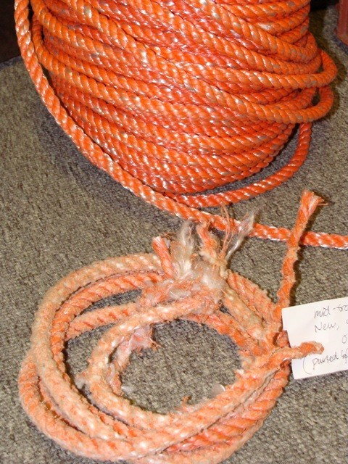
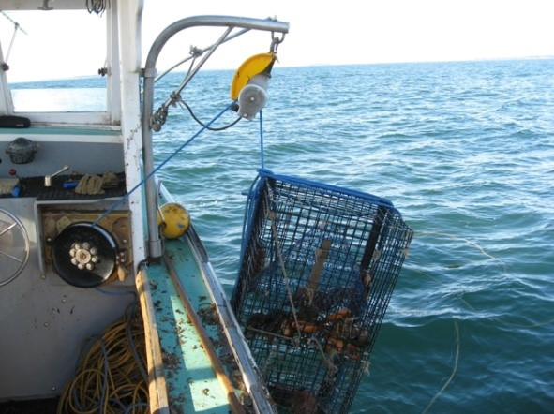
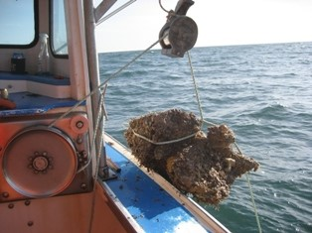
Operational Challenges Sinking Groundline

Slide 21
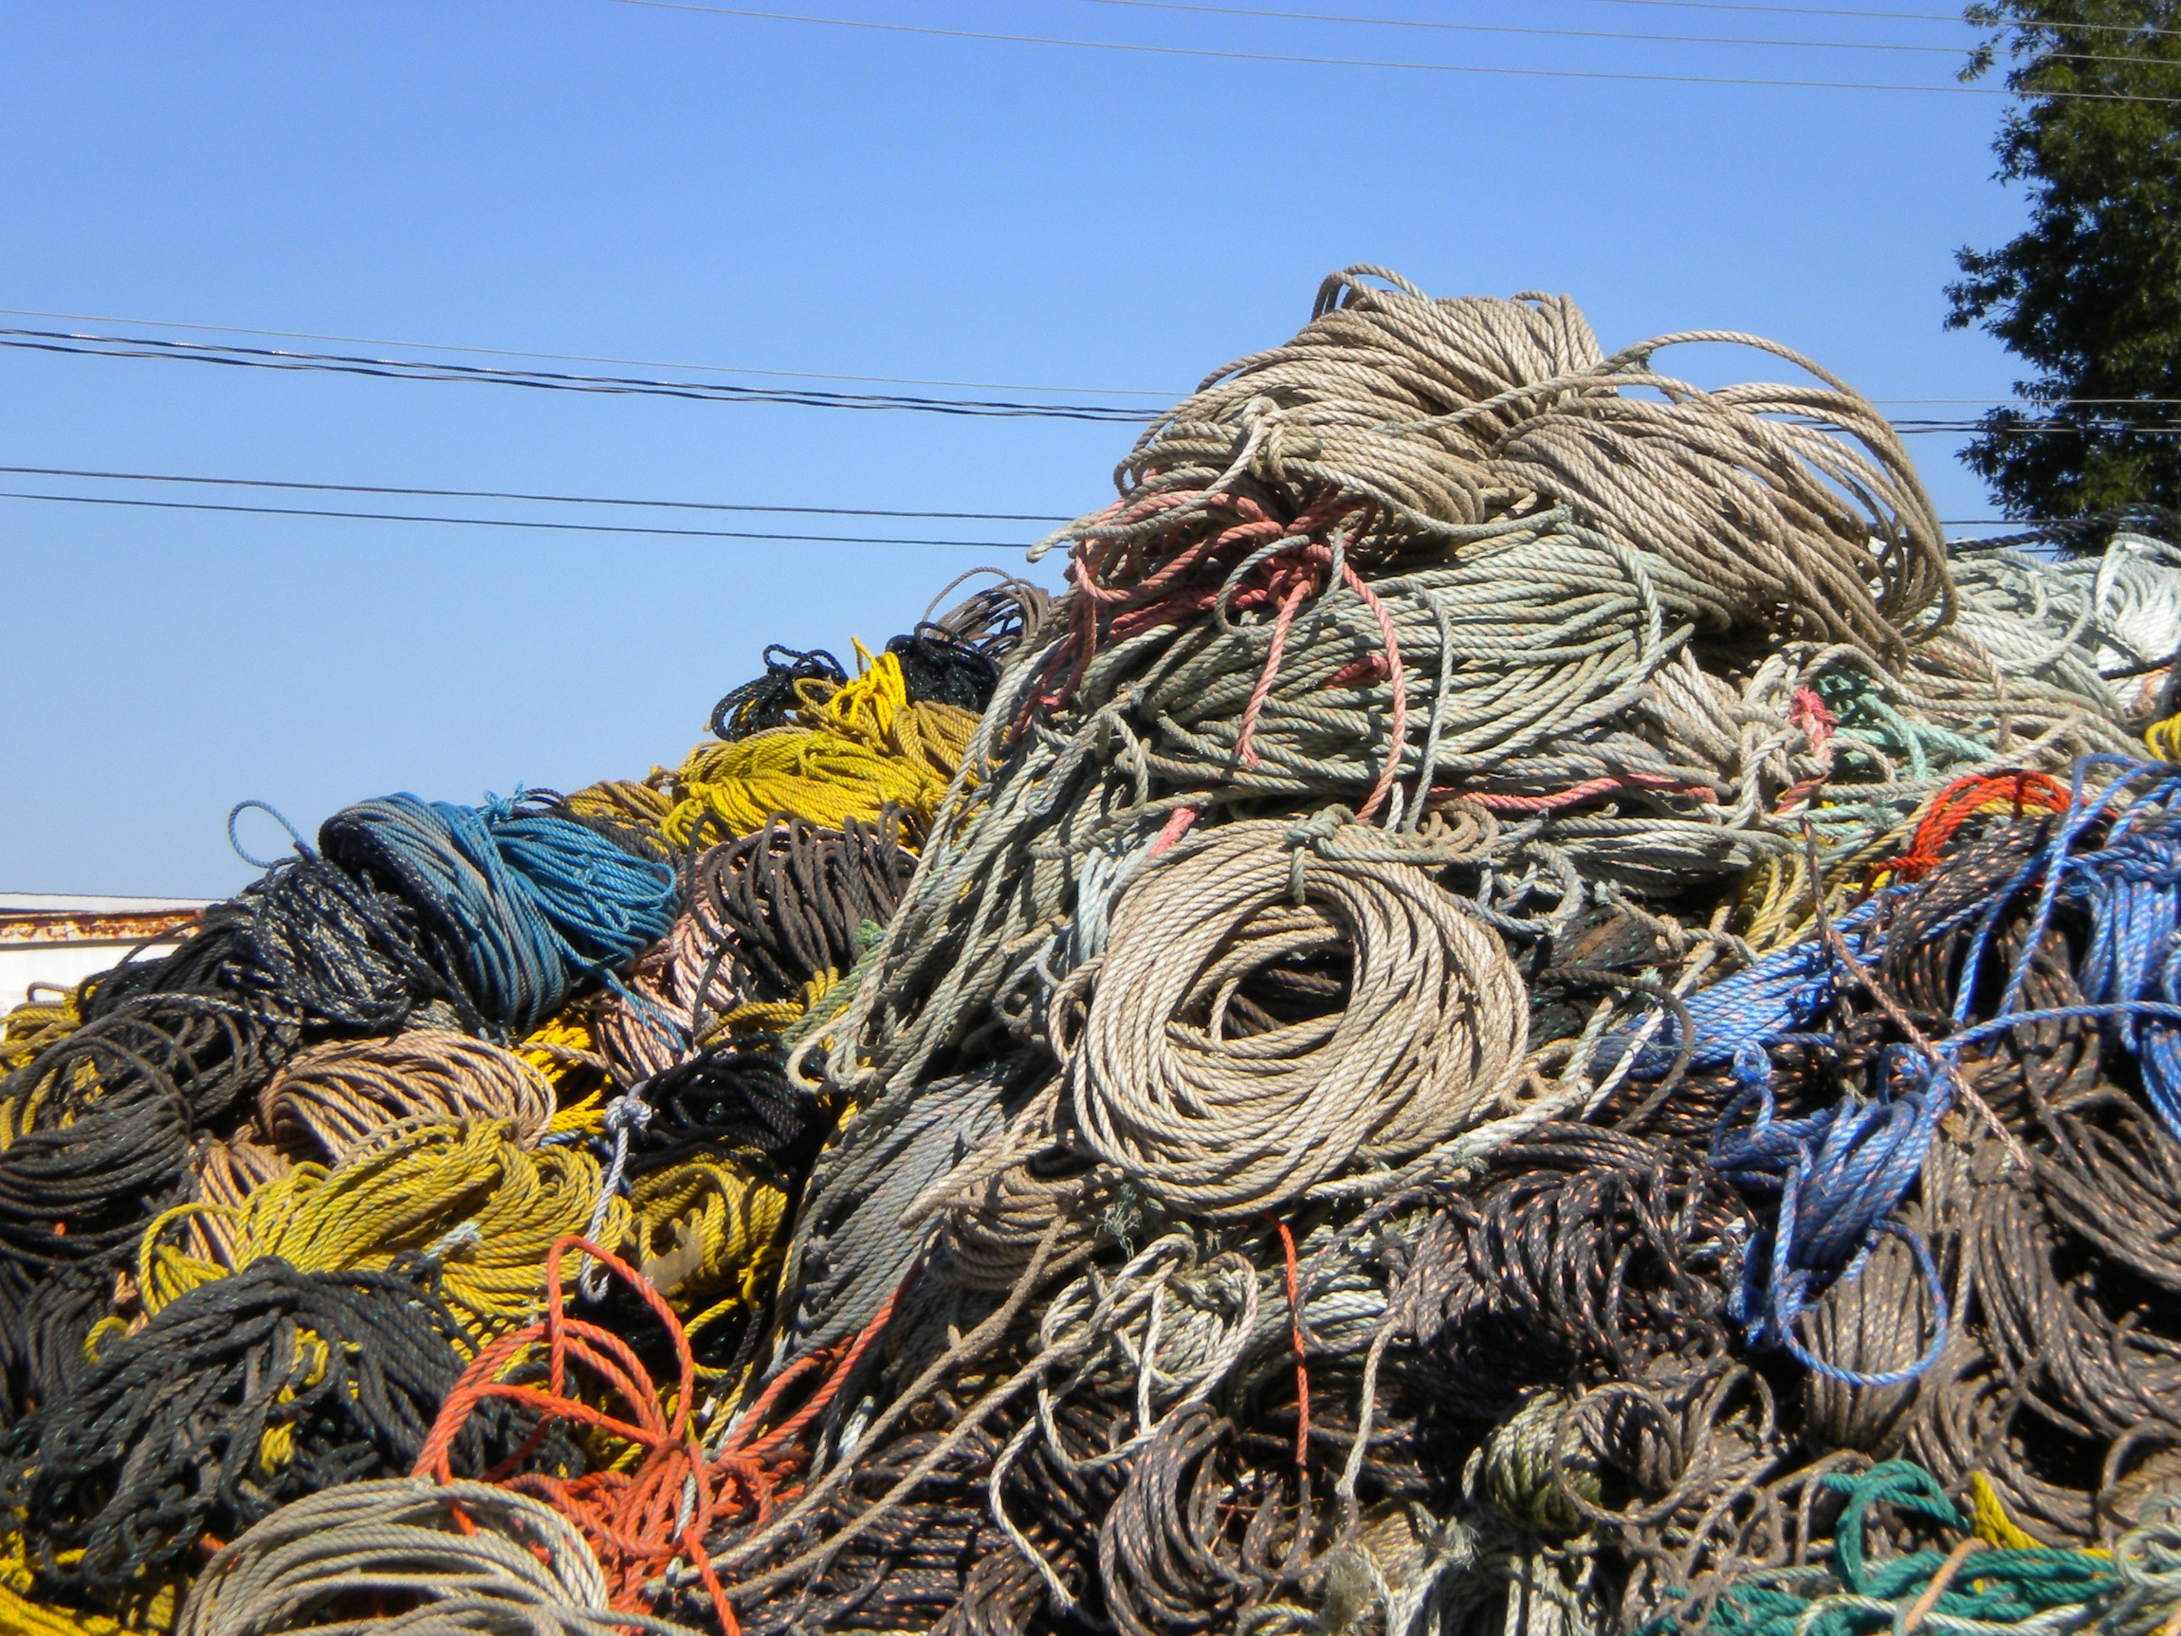
Sinking Groundline
Federally funded rope buyback
-trade in floating line, get voucher towards purchase of sink line
-sink rope wears out much faster
-increase cost of business

Slide 22
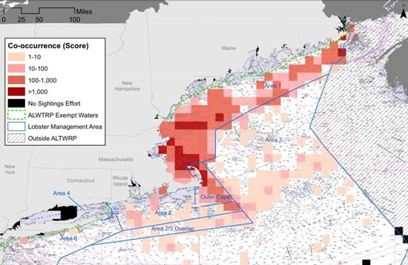
Co-occurrence model
Address Vertical Lines

Slide 23
Tries to address risk
Looks at overlap of whales and gear
  Only looks at vertical lines
  Does not look at whale behavior (feeding, transiting, etc.)
  Does not look at size or weight of gear
Inshore
Lots of gear and fewer whales
Lighter gear (shorter trawls, lighter traps and ropes)
Offshore
Less gear and more whales
Heavier gear (long trawls, heavy traps, big rope)
Which is more risky????

Slide 24
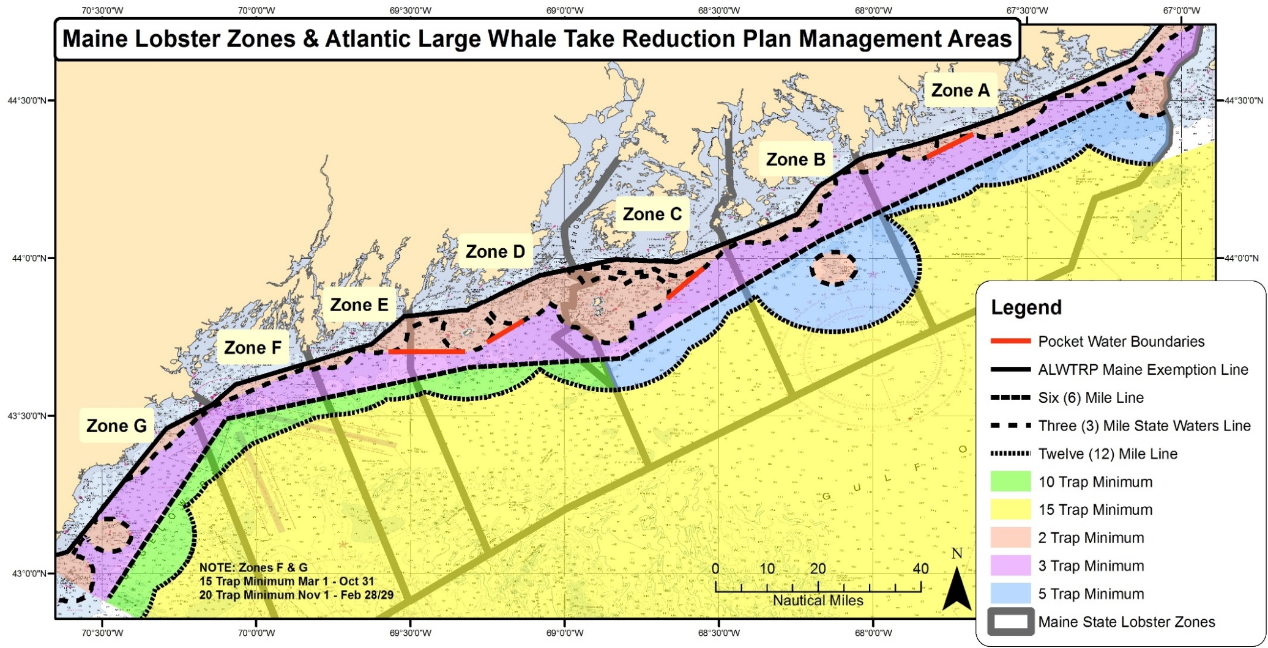
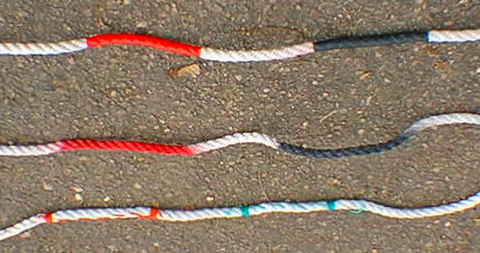
Vertical lines: Minimum Traps per Trawl [2015]
Gear marking VL expanded to three 12” marks
Notes:
Regardless of the process, it’s hard to be the regulated community

Slide 25
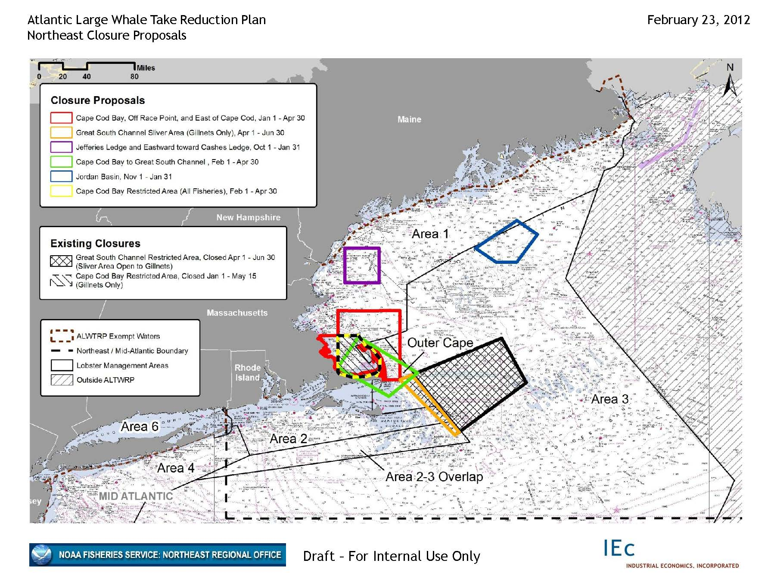
Maine has avoided closures

Slide 26
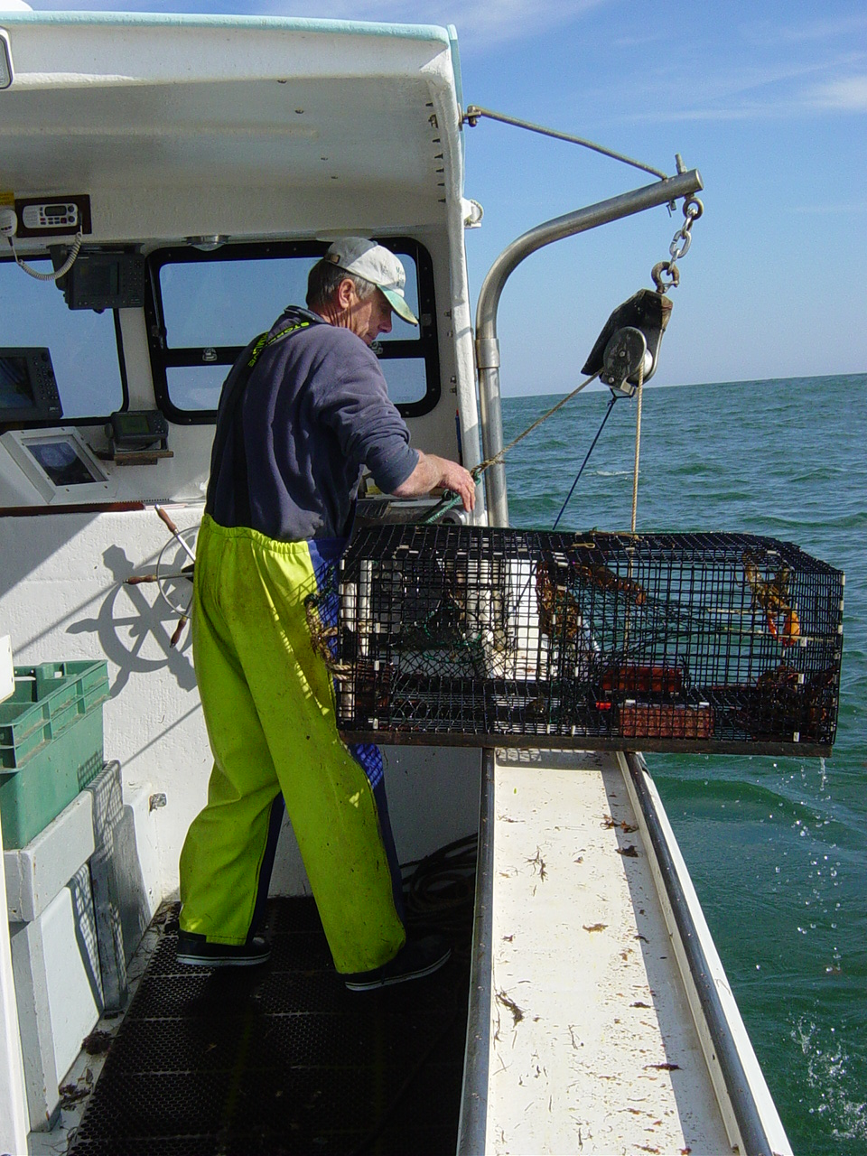
Whale Plan Compliance
FY 15
585 lobster vessels checked
95% compliance

Slide 27
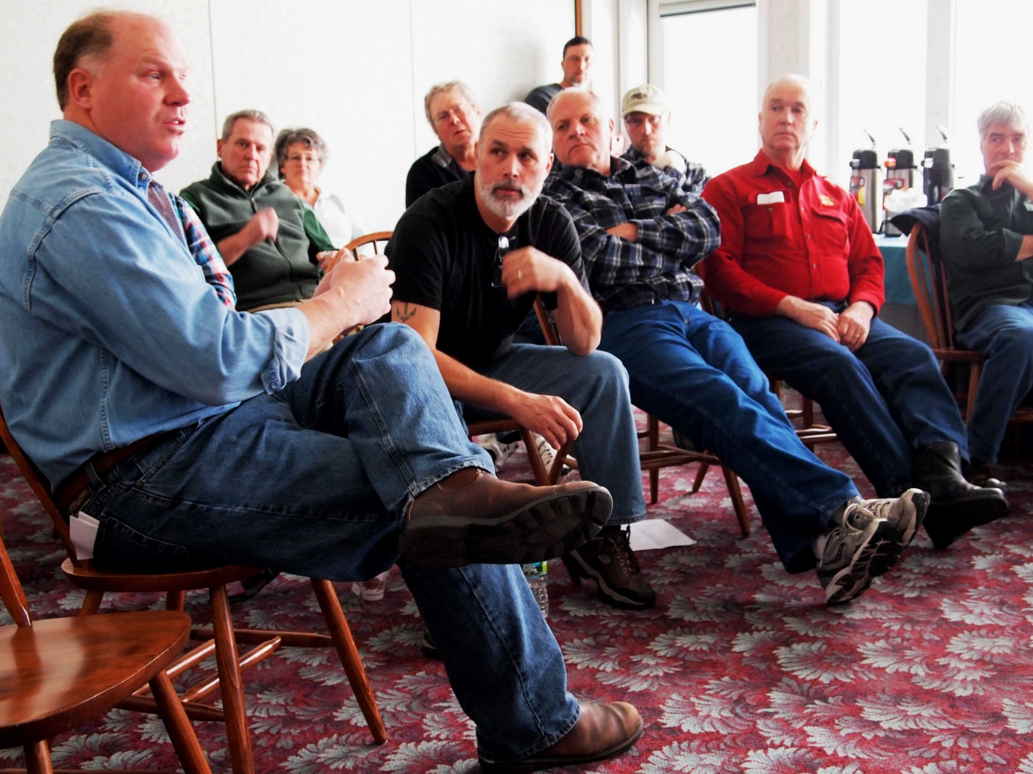
Need to Engage the Industry

Slide 28

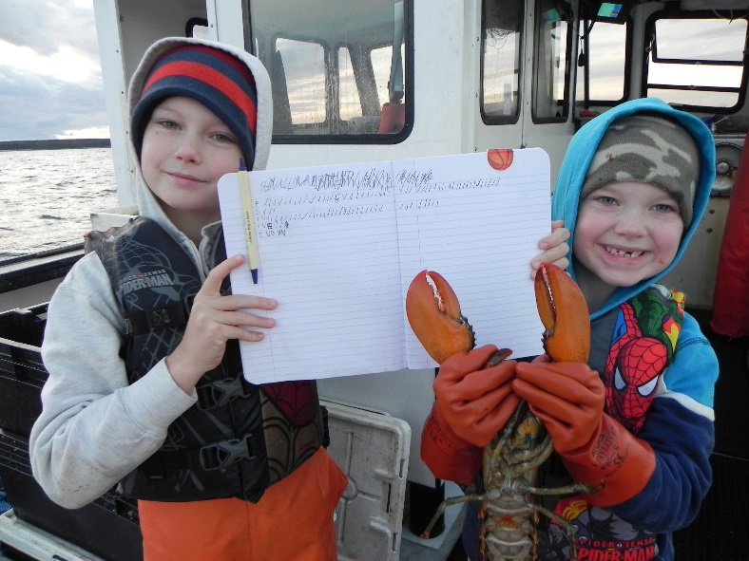
Challenging Issue
Regulated community
  feel like they have everything to lose
Management has a cost
  no guarantee that measures will solve the problem
Notes:
Regardless of the process, it’s hard to be the regulated community

Slide 29
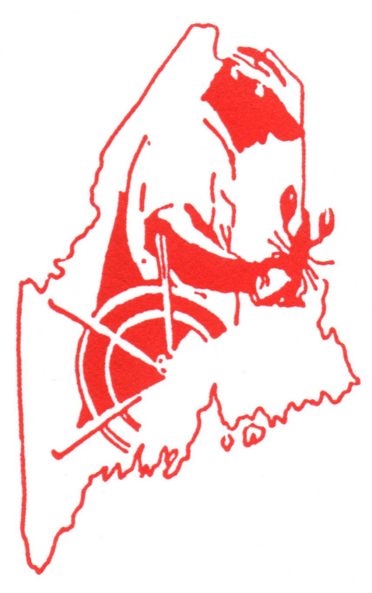
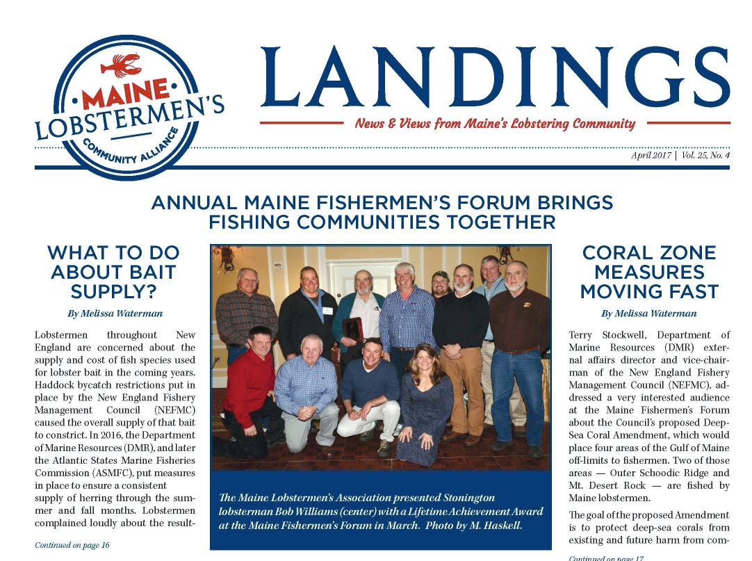
Engaging the lobster industry
Participate in the process
  Political and regulatory (TRT, agency, delegation)
  Partner with researchers (NEAq, WHOI, state)
  MLA Legal Defense Fund
Make sure lobstermen have options to fish
  Research on groundline and vertical line
  Research on gear removed from whales
  Document Maine’s story
Education
  Meetings
  newsletter articles

Slide 30
Engage with research community
1990’s
  Worked with NMFS (gear profiles, weak links, exploring gear mods)
2000’s
  Establish methods for weak links (NMFS, DMR)
  Buoy line marking methods (NMFS, DMR)
  Vessels host ROV survey (DMR)
  Test neutrally buoyant, low profile and sink ropes (DMR, BC)
  Measure rope profiles with pressure sensors (DMR)
  Test vertical line mods; glow and stiff rope, cutters (BC)
2010’s
  Map lobster industry (gear configurations) (BC)
  Develop fishing gear/whale risk model (WHOI)
  Document sink rope chafing and profiles (BC)
  Explore ideas for best practices (BC)
  Produce sink rope report (BC)
  Exploring “weak” ropes

Slide 31
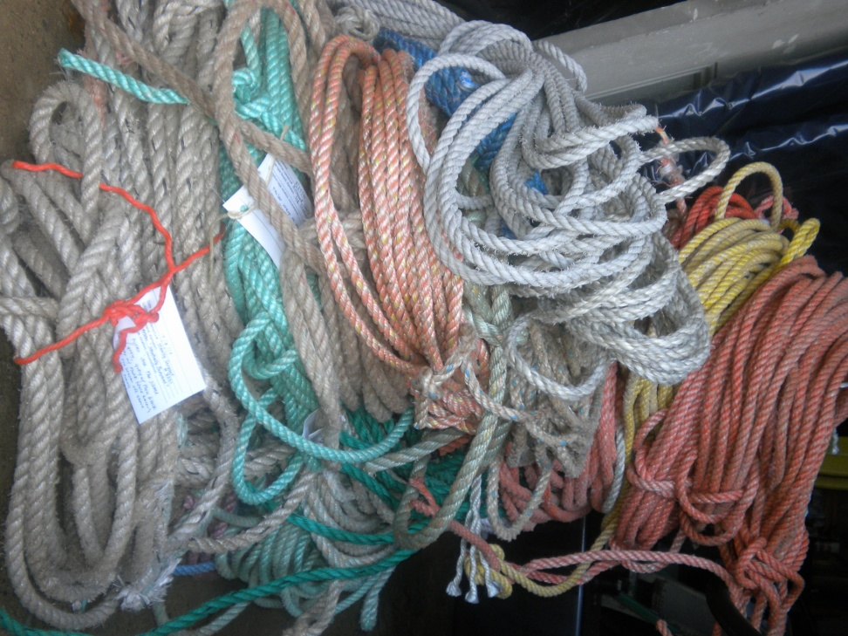
How do whales become entangled?
What do we fix?

Slide 32
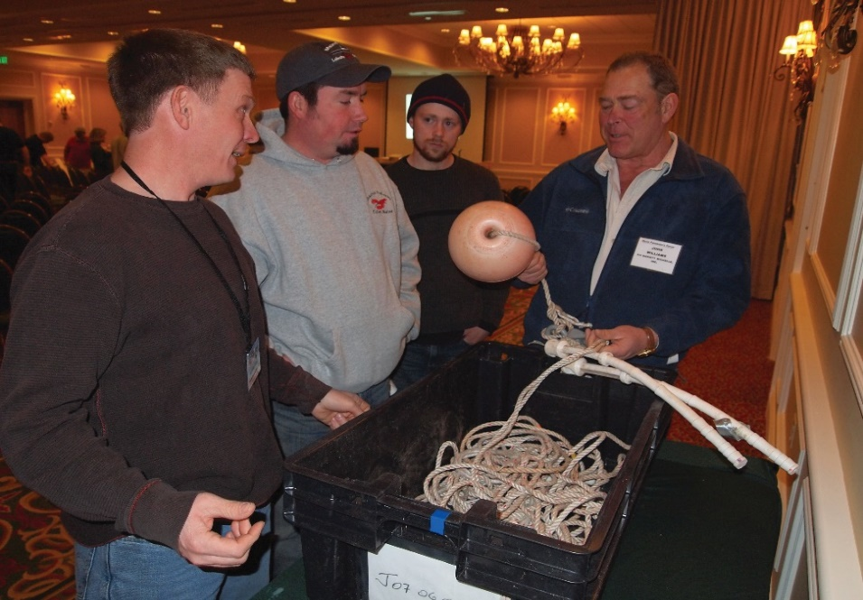
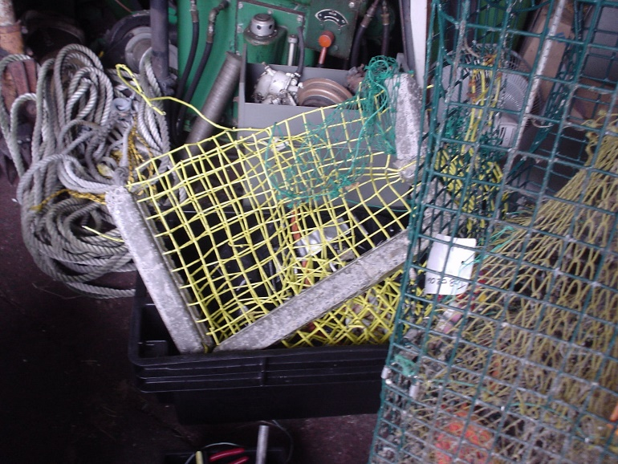
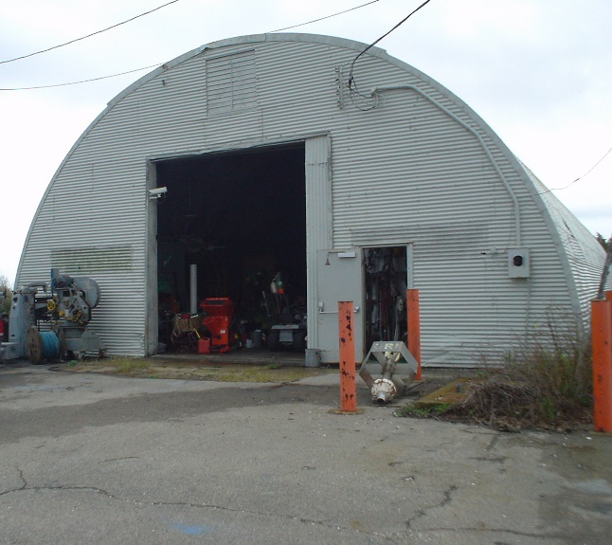
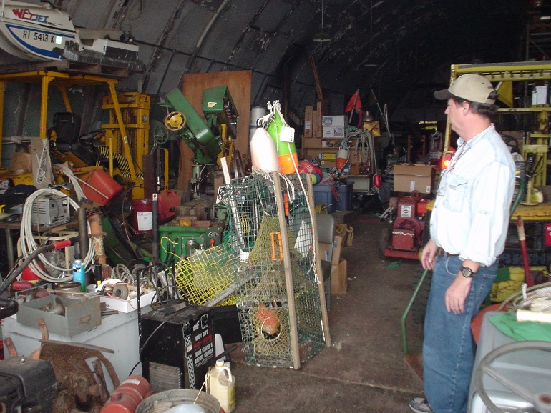
How do whales get entangled?
Examine gear removed from whales
Visit warehouse of gear removed from whales
Brought gear removed from whales and case studies to Maine

Slide 33
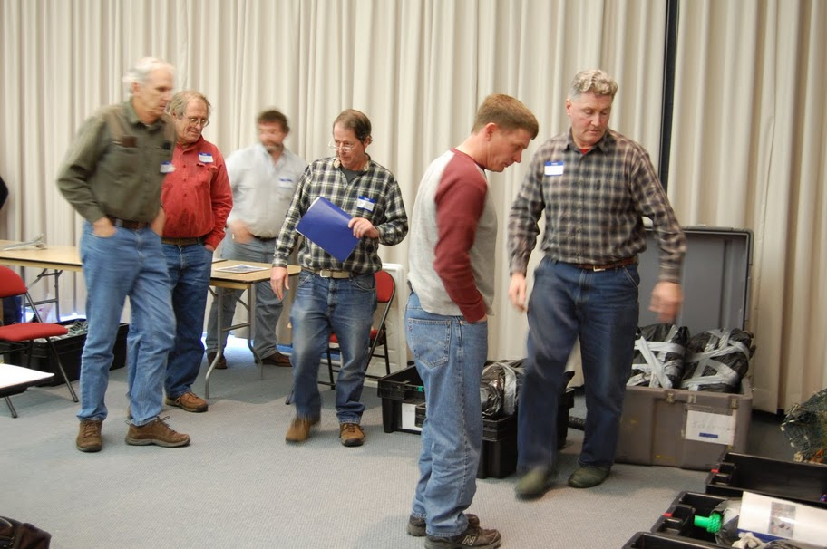
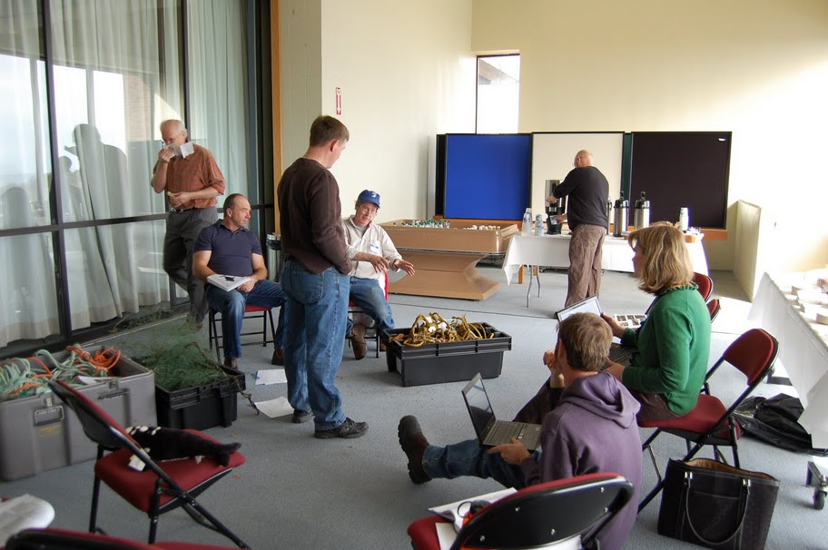
Reverse Engineering
Bring together fishermen, scientists & rope manufactures
Look at all of the information we have about whales and the entanglement event

Slide 34

Need to explain our fishery to others if we are to work together to solve entanglement
Need to assess risk of entanglement

Slide 35

Document Lobster Fishery
-Worked with lobstermen to describe Maine lobster fishery & gear
-Documented how, when and where we fish
-Produced a resource book
-Produced a risk model with
-NEAq and Woods Hole

Slide 36



Slide 37


Slide 38


Gear Density by Month

Slide 39

Whale Activity by Season

Slide 40

Baseline: Expected Encounters per Year
VL 3,679
GL 97
total 3,776

Slide 41

Document Lobster Fishery

Slide 42


Document Lobster Fishery

Slide 43




Break Testing Used Sink Rope Results Are we retiring rope too early?
Rope Name | Size | Time fished | Virgin | Used | Visual | % Loss
SteeLiner (Hyliner) | 7/16” | 18 months Cutler | 5430 | 3170 | 4/5 (bad) | 53%
HydroPro (Polysteel) | 7/16” | 6 months BucksHarbor | 4120 | 2760 | 10 (unfishable) | 40%
HydroPro (Polysteel) | 3/8” | 3 months Stonington | 3485 | 3130 | 7 (bad) | 17%
Everson | 3/8” | 10 months Port Clyde | 4180 | 3325 | 7 (bad) | 23%
Notes:
The visual assessment is how bad lobstermen thought the rope looked.

Slide 44




Underwater Video of Sink Rope

Slide 45


Document what has worked

Slide 46



Looking for Whale Safe Ropes
Groundlines
  Chafe resistant
    (barium sulfate sink, braided metallocene sink)
  Profile of rope in water column
    Develop low profile ropes
    DST pressure sensors
Vertical Lines
  Avoidance
    glow rope
    Colored rope
  Low entanglement risk
    stiff rope
    weak rope
    time tension line cutter

Slide 47

Best Practices
Common sense ideas to make gear safer

Slide 48

Ideas to Avoid/Reduce Severity of Entanglement
Maximize traps/endline
Groundline
  Use sink rope
  Deploy with taught line
Surface system
  Limit scope
  Limit rope between buoys
  Weaker rope on top 1/3
  Reduce # of flotation devices
Reduce knots and coils in VL
  Splice instead of knot
  Lengthen rather than coil/shank
Reduce gear density through trap reducations
Investigate stiff line/taught line
Reduce ghost gear
  Improve deployment of groundlines

Slide 49

What’s next?
Continue with TRT process
Canada developing a whale plan
Continue to educate the industry
More weak ropes to be tested
Not testing acoustic release devices
Basic questions have not been answered
Has trawling up made things better or worse?
Whales aren’t doing well; why?
NMFS monitoring the effectiveness of the plan (5 year process)

Slide 50

Thank you!

